Slide 1
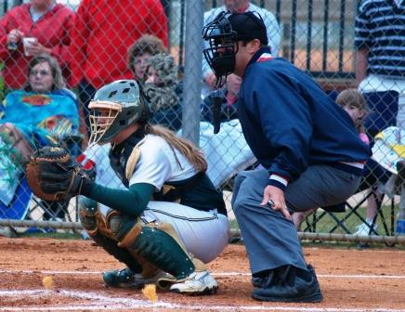
Fast Pitch Plate Mechanics

Slide 2
Mechanics
Plate Umpire…
- Always remove mask when ball is hit.
- Exit left of plate every time*.
- Trail runner to 1st in most cases.
- Be prepared to move to 2^{nd,} 3rd or back home.
- Ball and chain is not standard equipment.

Slide 3
We use the hammer…
…try not to point

Slide 4
Work the slot.

Slide 5
On both sides of the plate

Slide 6
Try to keep your eyes at the top level of the zone.

Slide 7
Follow the ball

Slide 8
Watch your hands…

Slide 9
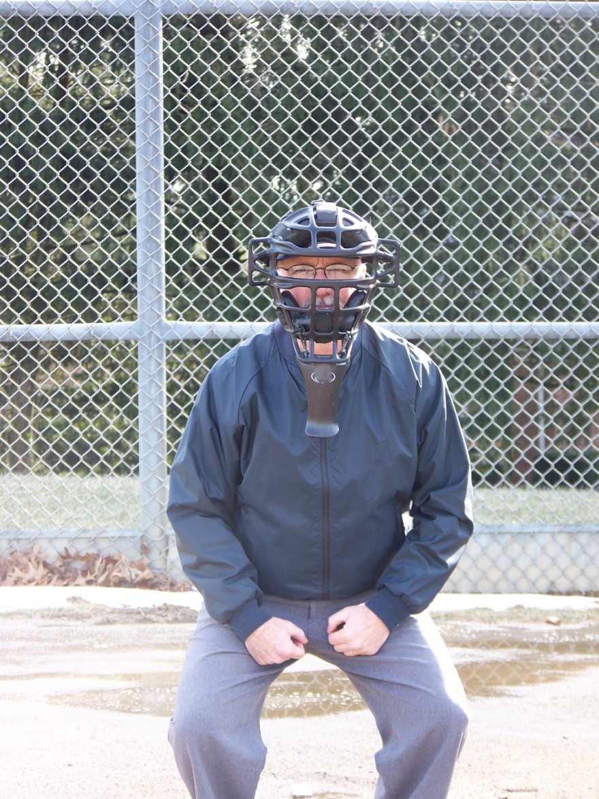
Set position behind the plate (mine)

Slide 10
For a called strike, verbalize it in the down position.

Slide 11
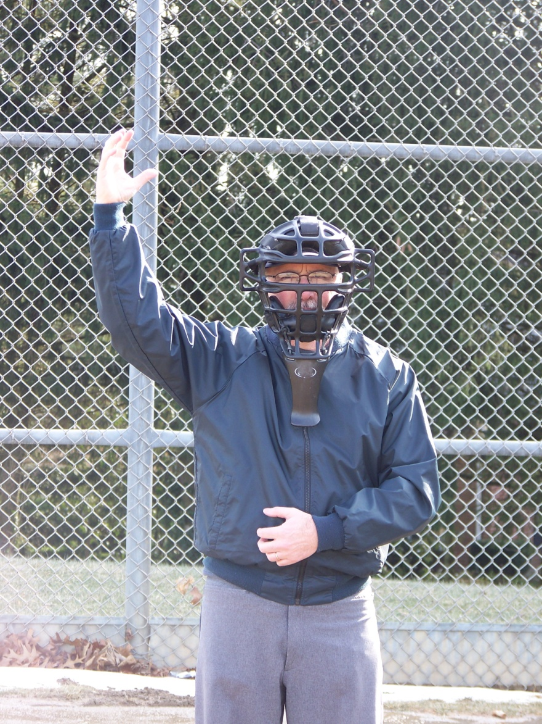
Then begin your signal as you rise..

Slide 12
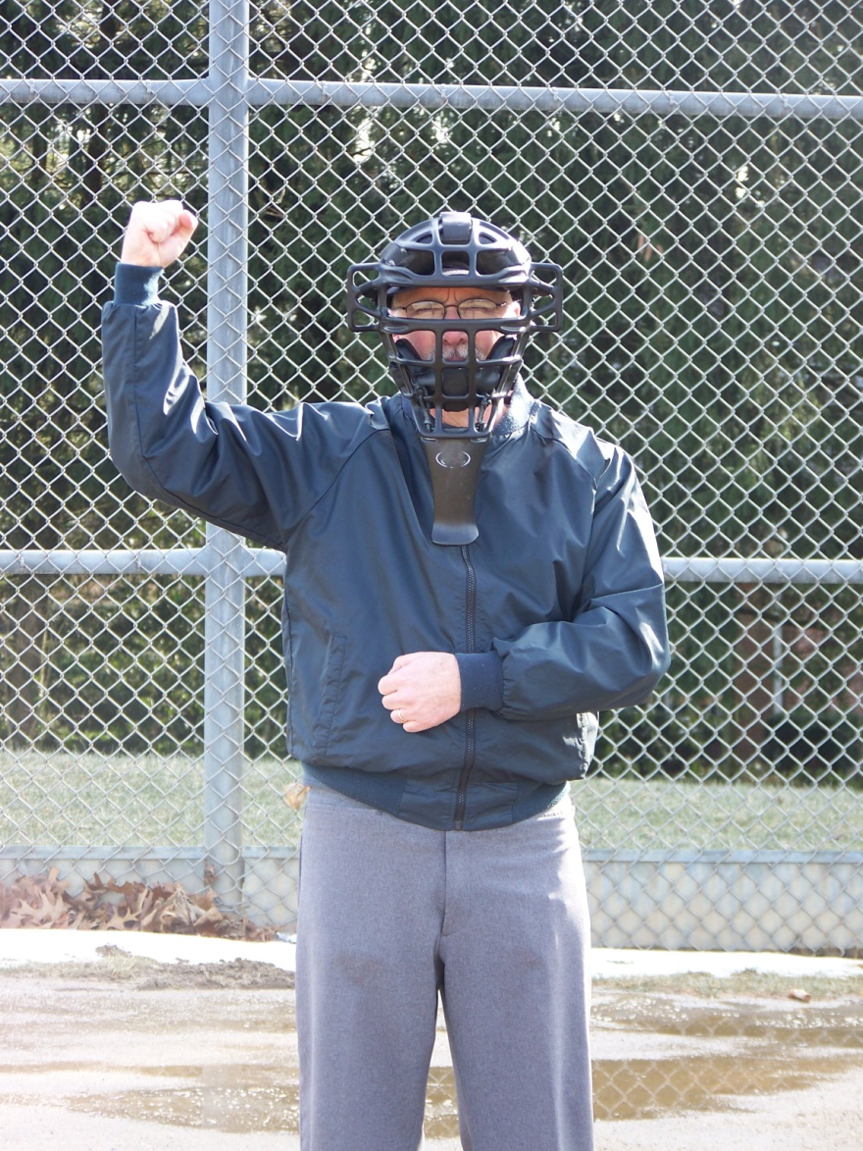
End with the 90 degree hammer

Slide 13
For a called ball, stay in set position, verbalize “ball”, then rise.

Slide 14
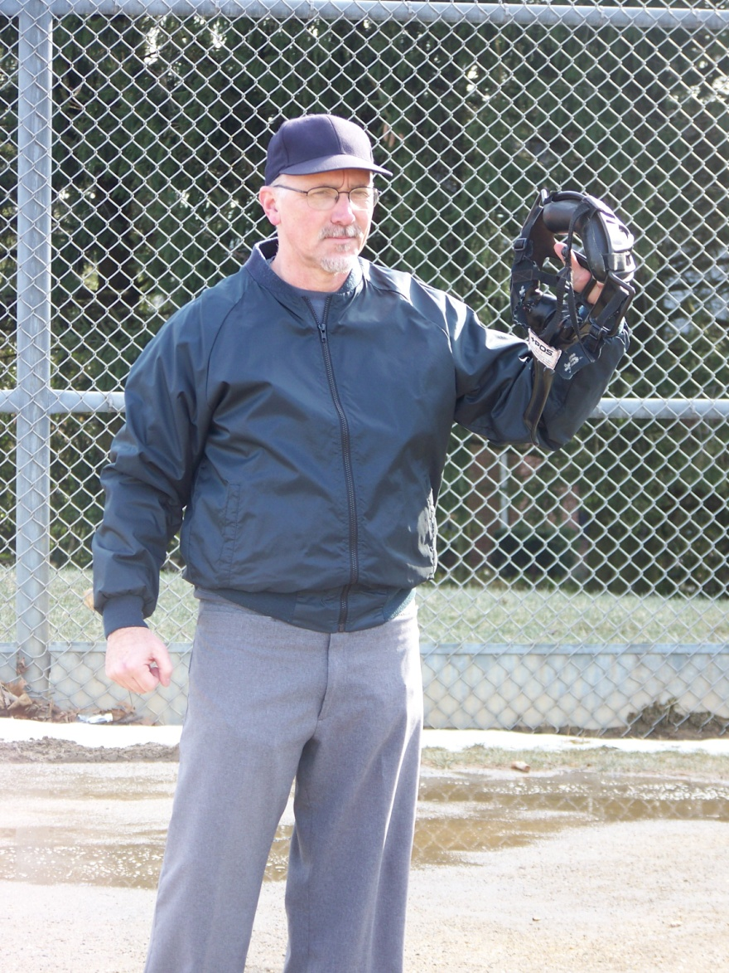
On a hit, mask off, exit left every time*

Slide 15
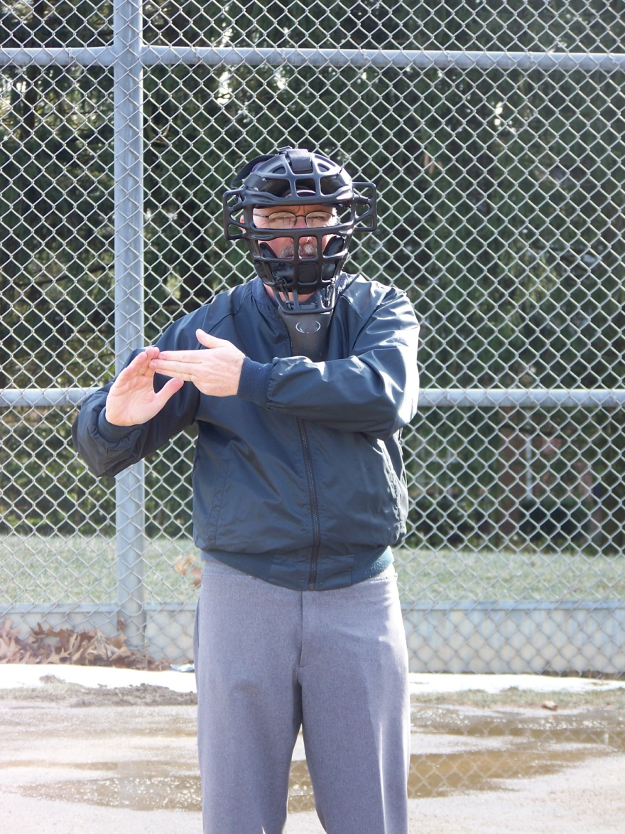
Foul tip (followed by strike signal)

Slide 16
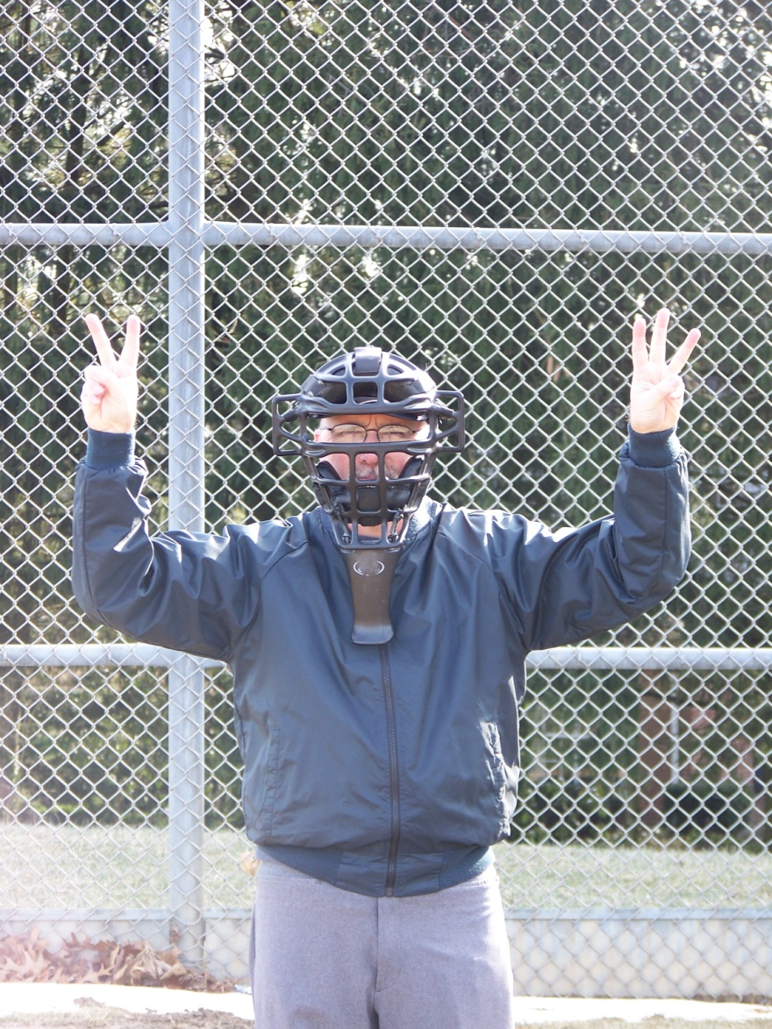
Count (with consecutive fingers)

Slide 17
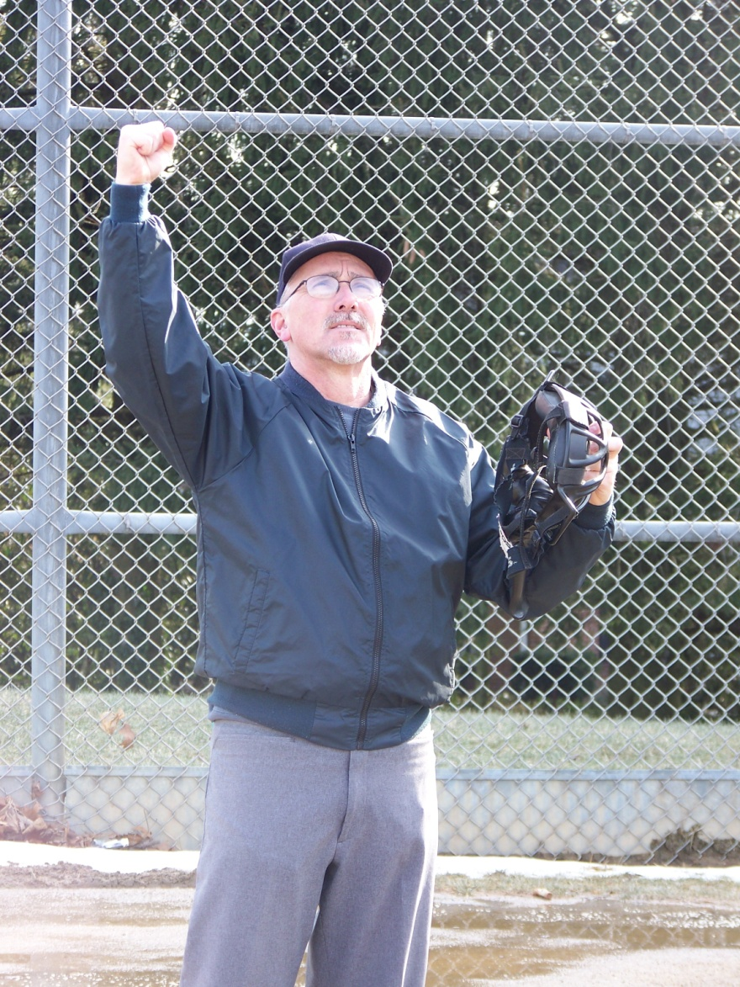
Infield fly (more later)

Slide 18
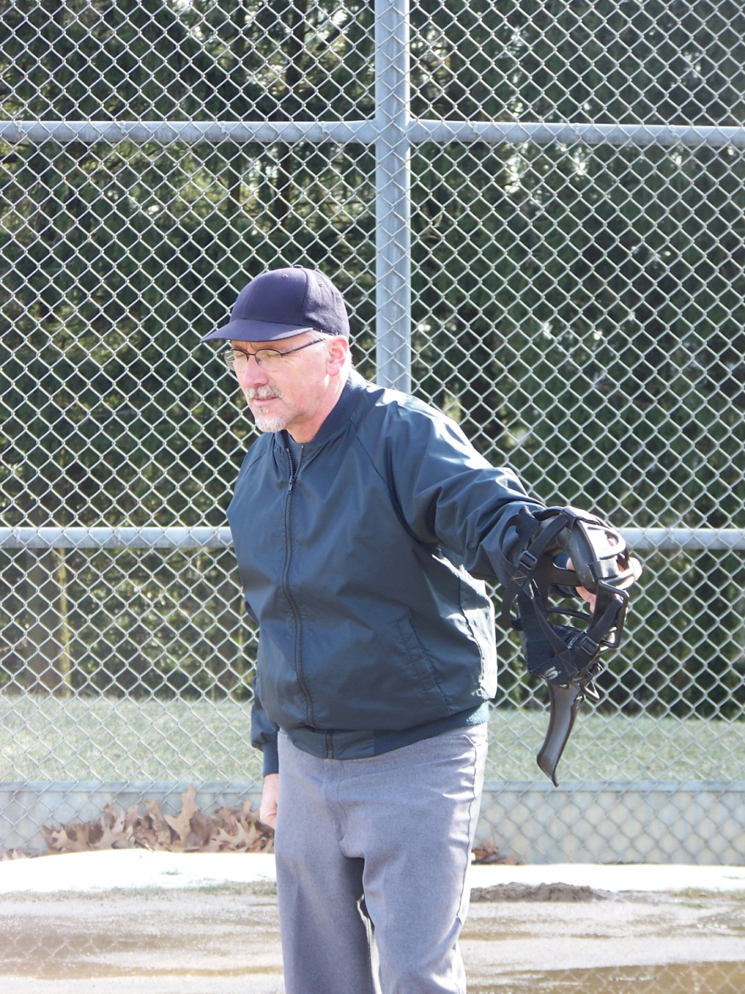
Fair ball (1st base line)

Slide 19
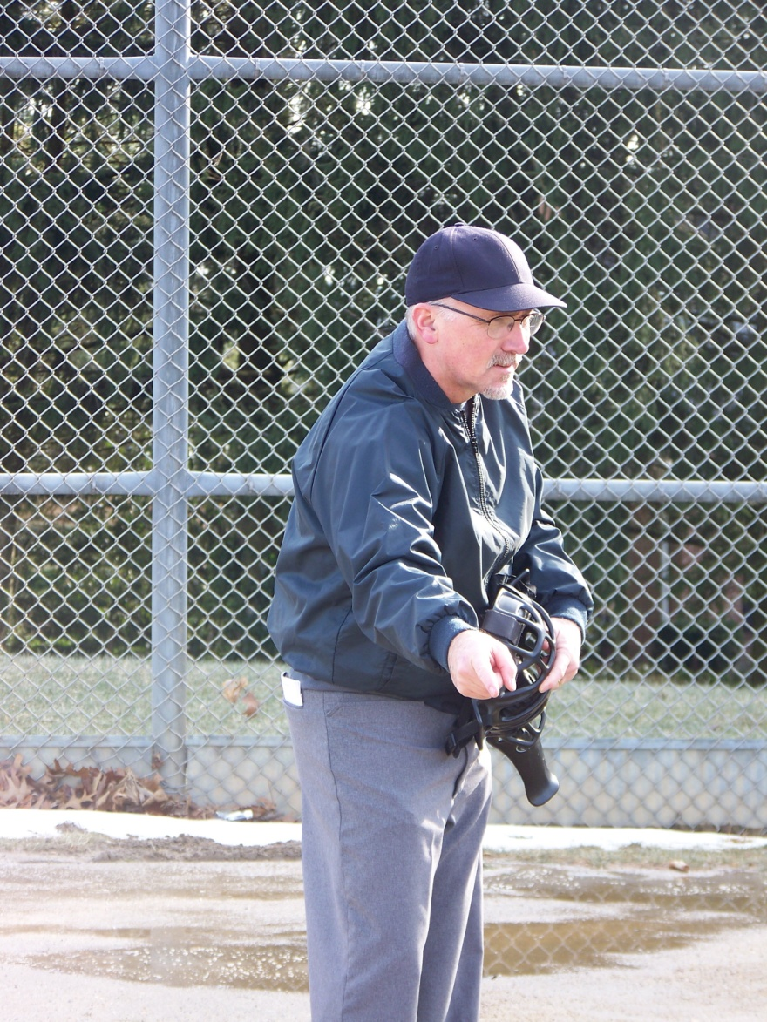
Fair ball (3rd base line)

Slide 20
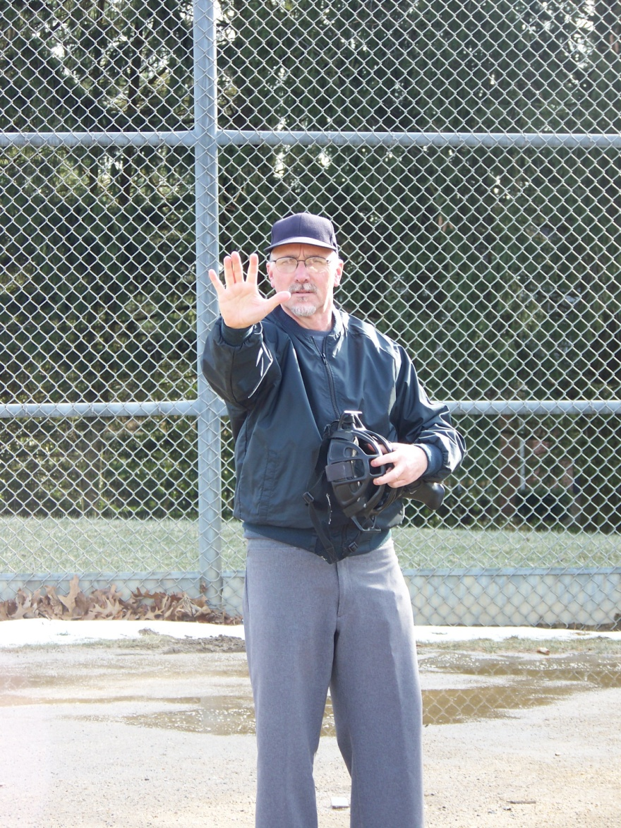
Don’t pitch

Slide 21
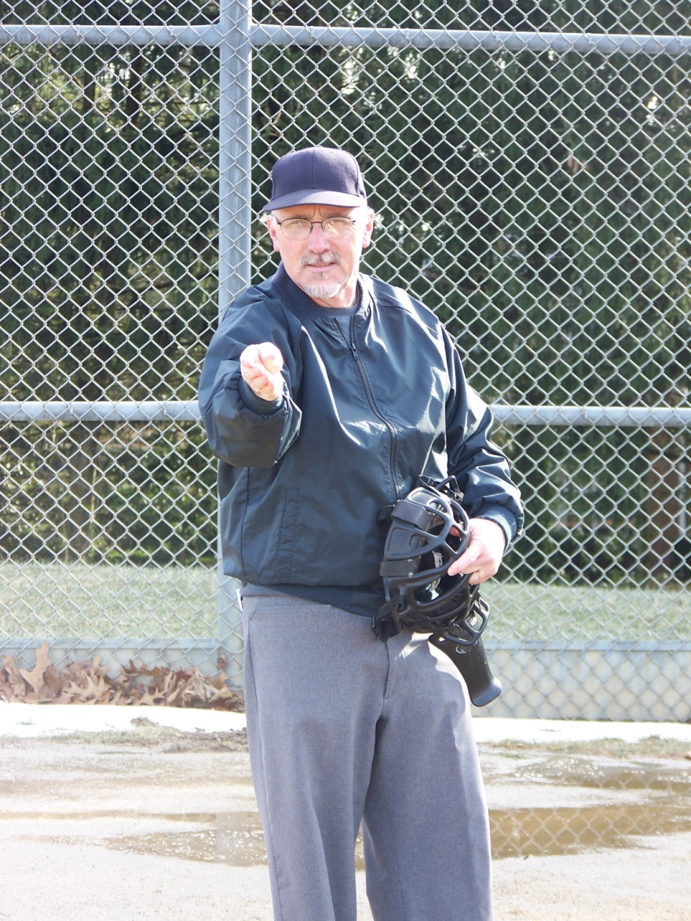
Signal to pitch/play

Slide 22
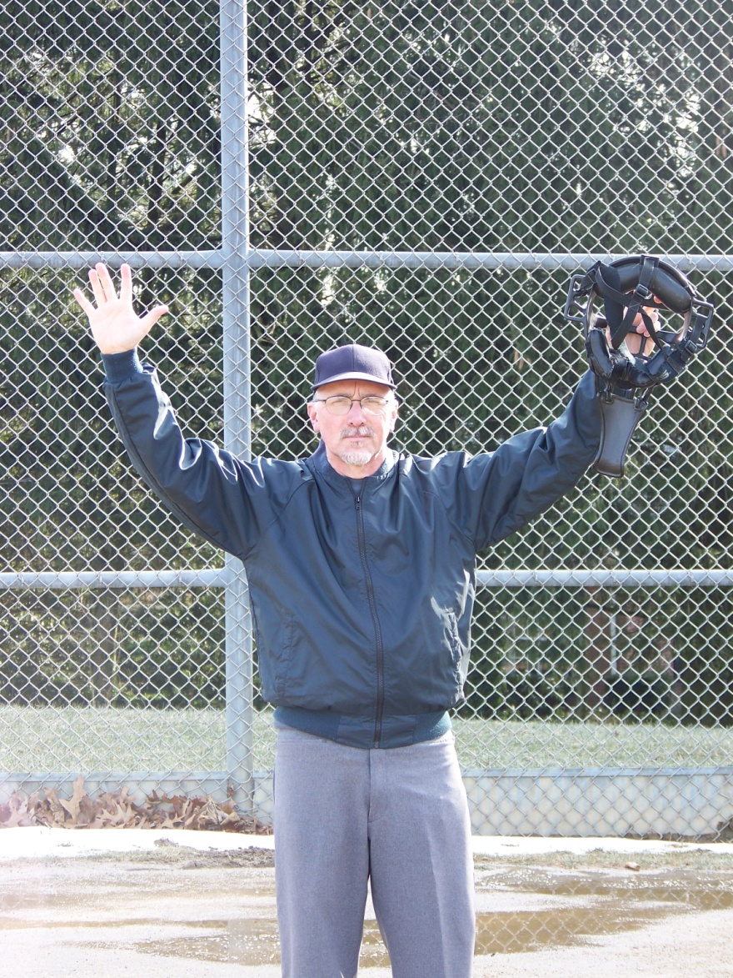
Dead ball. Foul Ball.

Slide 23
The return of the infield fly…
Plate umpire’s call. Base umpire mirrors signal.
Can the base umpire gives their non-verbal interpretation?
Runners at 1st and 2nd (or 1st, 2nd and 3rd).
Before the ball is pitched, both umpires signal each other.

Slide 24
The return of the infield fly (cont.)…
When fair fly ball reaches it’s apex…
- can an infielder make the catch using normal effort? (but remember, an outfielder can make the catch).
- if in your judgement…right arm up with hand in fist (base umpire responds with same signal).
- “infield fly, batter is out”
- if ball is near foul line, “infield fly if fair, batter’s out”

Slide 25
And…
Can a base umpire overrule the plate umpire? No.
Can the infield fly be applied retro-actively? Yes.
- coach reminds umpire about infield fly situation.
- one umpire calls time and confers with partner about missing the infield fly. Plate umpire announces and explains.

Slide 26
Ball & strike count
Height
Consecutive fingers (with a verbal)
Rotation
How often?

Slide 27
Fast Pitch Slot
Outside perimeter of the strike zone.
Eyes at the top of the strike zone.
Slightly inside the inside corner of the plate.

Slide 28
Strike calls
Vocal. No description.
Timing. Wait.
Called as you move to full height (or as strike three is called).
Ball calls
Vocal. No description.
Timing. Wait.
Called in down position.

Slide 29
Always…
Consistency
Intensity
Believability

